Slide 2
Chapter 3
E-commerce Infrastructure: The Internet, Web, and Mobile Platform
Copyright © 2014 Pearson Education, Inc.

Slide 3
Google Glass: Augment My Reality
Have you used any augmented reality applications? If so, has it been useful; if not, is it a service that seems interesting? Why or why not?
Are there any privacy issues raised by augmented reality applications?
What are the potential benefits? Are there any disadvantages?
What revenue models could work for providers of augmented services?
Copyright © 2014 Pearson Education, Inc.
Slide 3-<number>

Slide 4
The Internet: Technology Background
Internet
  Interconnected network of thousands of networks and millions of computers
  Links businesses, educational institutions, government agencies, and individuals
World Wide Web (Web)
  One of the Internet’s most popular services
  Provides access to billions, possibly trillions, of Web pages
Copyright © 2014 Pearson Education, Inc.
Slide 3-<number>

Slide 5
The Evolution of the Internet:
1961–Present
Innovation Phase, 1964–1974
  Creation of fundamental building blocks
Institutionalization Phase, 1975–1995
  Large institutions provide funding and legitimization
Commercialization Phase, 1995–present
  Private corporations take over, expand Internet backbone and local service
Copyright © 2014 Pearson Education, Inc.
Slide 3-<number>

Slide 6
The Internet:
Key Technology Concepts
Defined as network that:
  Uses IP addressing
  Supports TCP/IP
  Provides services to users, in manner similar to telephone system
Three important concepts:
  Packet switching
  TCP/IP communications protocol
  Client/server computing
Copyright © 2014 Pearson Education, Inc.
Slide 3-<number>

Slide 7
Packet Switching
Slices digital messages into packets
Sends packets along different communication paths as they become available
Reassembles packets once they arrive at destination
Uses routers
  Special purpose computers that interconnect the computer networks that make up the Internet and route packets
  Routing algorithms ensure packets take the best available path toward their destination
Less expensive, wasteful than circuit-switching
Copyright © 2014 Pearson Education, Inc.
Slide 3-<number>

Slide 8
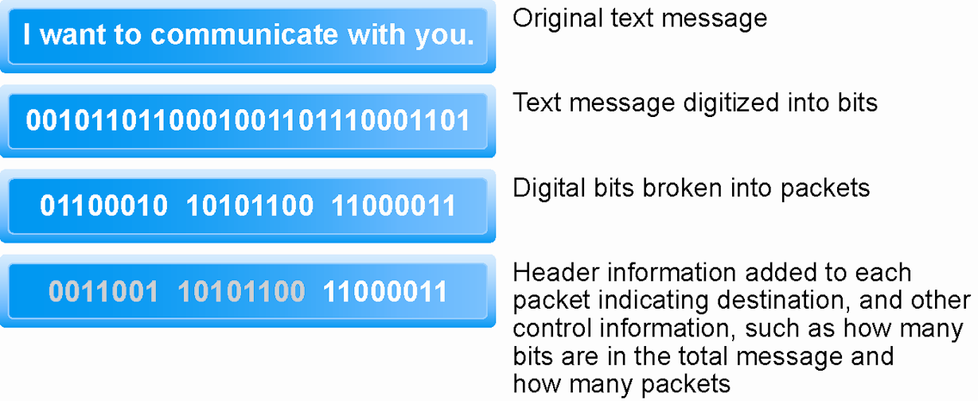
Packet Switching
Figure 3.2, Page 74
Copyright © 2014 Pearson Education, Inc.
Slide 3-<number>

Slide 9
TCP/IP
Transmission Control Protocol (TCP)
  Establishes connections among sending and receiving Web computers
  Handles assembly of packets at point of transmission, and reassembly at receiving end
Internet Protocol (IP)
  Provides the Internet’s addressing scheme
Four TCP/IP layers
  Network interface layer
  Internet layer
  Transport layer
  Application layer
Copyright © 2014 Pearson Education, Inc.
Slide 3-<number>

Slide 10
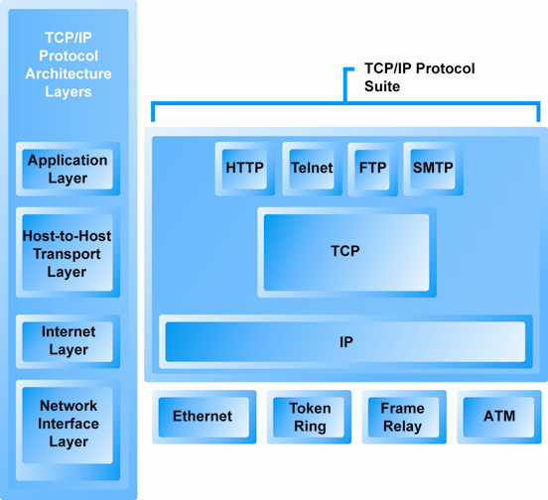
The TCP/IP Architecture and Protocol Suite
Figure 3.3, Page 75
Copyright © 2014 Pearson Education, Inc.
Slide 3-<number>

Slide 11
Internet (IP) Addresses
IPv4
  32-bit number
  Four sets of numbers marked off by periods: 201.61.186.227
    Class C address: Network identified by first three sets, computer identified by last set
IPv6
  128-bit addresses, able to handle up to 1 quadrillion addresses (IPv4 can only handle 4 billion)
Copyright © 2014 Pearson Education, Inc.
Slide 3-<number>

Slide 12
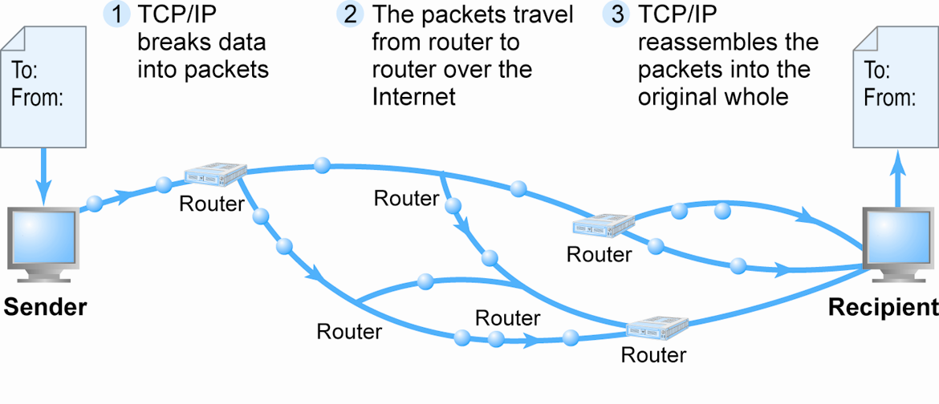
Routing Internet Messages: TCP/IP and Packet Switching
Figure 3.4, Page 77
Copyright © 2014 Pearson Education, Inc.
Slide 3-<number>

Slide 13
Domain Names, DNS, and URLs
Domain name
  IP address expressed in natural language
Domain name system (DNS)
  Allows numeric IP addresses to be expressed in natural language
Uniform resource locator (URL)
  Address used by Web browser to identify location of content on the Web
  e.g.: http://www.azimuth-interactive.com/flash_test
Copyright © 2014 Pearson Education, Inc.
Slide 3-<number>

Slide 14
Client/Server Computing
Powerful personal computers (clients) connected in network with one or more servers
Servers perform common functions for the clients
  Storing files
  Software applications
  Access to printers, etc.
Copyright © 2014 Pearson Education, Inc.
Slide 3-<number>

Slide 15
The New Client:
The Mobile Platform
In a few years, primary Internet access will be through:
  Tablets
    Supplementing PCs for mobile situations
  Smartphones
    Disruptive technology
      Shift in processors, operating systems
    25% of all cell phones
Copyright © 2014 Pearson Education, Inc.
Slide 3-<number>

Slide 16
Cloud Computing
Firms and individuals obtain computing power and software over Internet
  e.g.: Google Apps
Fastest growing form of computing
Radically reduces costs of:
  Building and operating Web sites
  Infrastructure, IT support
  Hardware, software
Copyright © 2014 Pearson Education, Inc.
Slide 3-<number>

Slide 17
Other Internet Protocols and
Utility Programs
Internet protocols
  HTTP
  E-mail: SMTP, POP3, IMAP
  FTP, Telnet, SSL/TLS
Utility programs
  Ping
  Tracert
Copyright © 2014 Pearson Education, Inc.
Slide 3-<number>

Slide 18
The Internet Today
Internet growth has boomed without disruption because of:
  Client/server computing model
  Hourglass, layered architecture
    Network Technology Substrate
    Transport Services and Representation Standards
    Middleware Services
    Applications
Copyright © 2014 Pearson Education, Inc.
Slide 3-<number>

Slide 19
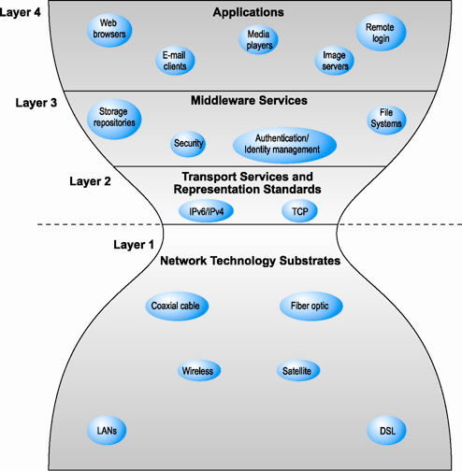
The Hourglass Model of the Internet
Figure 3.10, Page 85
Copyright © 2014 Pearson Education, Inc.
Slide 3-<number>

Slide 20
Internet Network Architecture
Backbone
  High-bandwidth fiber-optic cable networks
  Private networks owned by a variety of NSPs
  Bandwidth: 155 Mbps–2.5 Gbps
  Built-in redundancy
IXPs
  Hubs where backbones intersect with regional and local networks, and backbone owners connect with one another
CANs
  LANs operating within a single organization that leases Internet access directly from regional or national carrier
Copyright © 2014 Pearson Education, Inc.
Slide 3-<number>

Slide 21
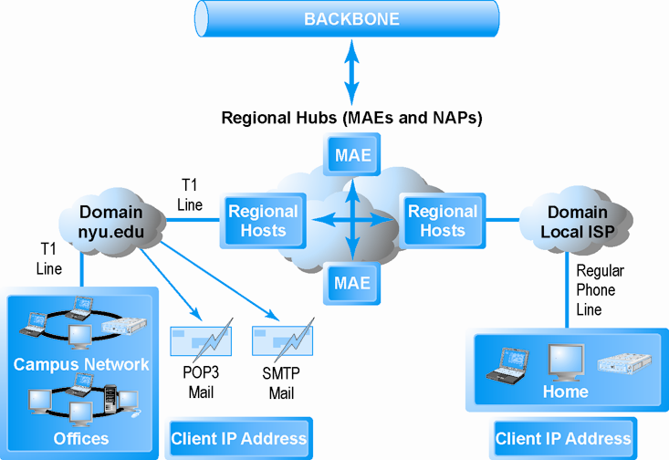
Internet Network Architecture
Figure 3.11, Page 86
Copyright © 2014 Pearson Education, Inc.
Slide 3-<number>

Slide 22
Internet Service Providers (ISPs)
Provide lowest level of service to individuals, small businesses, some institutions
Types of service
  Narrowband (dial-up)
  Broadband
    Digital Subscriber Line (DSL)
    Cable modem
    T1 and T3
    Satellite
Copyright © 2014 Pearson Education, Inc.
Slide 3-<number>

Slide 23
Intranets and Extranets
Intranet
  TCP/IP network located within a single organization for communications and processing
Extranet
  Formed when firms permit outsiders to access their internal TCP/IP networks
Copyright © 2014 Pearson Education, Inc.
Slide 3-<number>

Slide 24
Who Governs the Internet?
Organizations that influence the Internet and monitor its operations include:
  Internet Architecture Board (IAB)
  Internet Corporation for Assigned Names and Numbers (ICANN)
  Internet Engineering Steering Group (IESG)
  Internet Engineering Task Force (IETF)
  Internet Society (ISOC)
  World Wide Web Consortium (W3C)
  International Telecommunications Union (ITU)
Copyright © 2014 Pearson Education, Inc.
Slide 3-<number>

Slide 25
The Internet2 Project
Consortium of 350+ institutions collaborating to facilitate revolutionary Internet technologies
Primary goals:
  Create leading-edge very-high speed network for national research community
  Enable revolutionary Internet applications
  Distributed and collaborative computing environments for sciences, health, arts and humanities initiatives
Copyright © 2014 Pearson Education, Inc.
Slide 3-<number>

Slide 26
Fiber Optics and the Bandwidth
Explosion in the First Mile
“First mile”: Backbone Internet services that carry bulk traffic over long distances
Older transmission lines being replaced with fiber-optic cable
Much of fiber-optic cable laid in United States is “dark,” but represents a vast digital highway that can be utilized in the future
Technology improvement has also expanded capacity of existing fiber lines
Copyright © 2014 Pearson Education, Inc.
Slide 3-<number>

Slide 27
The Last Mile: Mobile Wireless Internet Access
“Last mile”: From Internet backbone to user’s computer, smartphone, etc.
Two different basic types of wireless Internet access:
  Telephone-based (mobile phones, smartphones)
  Computer network-based
Copyright © 2014 Pearson Education, Inc.
Slide 3-<number>

Slide 28
Telephone-based Wireless
Internet Access
Evolution:
  3G cellular networks: next generation, packet-switched
  3.5G (3G+)
  4G (WiMax, LTE)
Copyright © 2014 Pearson Education, Inc.
Slide 3-<number>

Slide 29
Wireless Internet Access
Network Technologies
Wi-Fi
  High-speed, fixed broadband wireless LAN (WLAN). Different versions for home and business market. Limited range.
WiMax
  High-speed, medium range broadband wireless metropolitan area network
Bluetooth
  Low-speed, short range connection
Copyright © 2014 Pearson Education, Inc.
Slide 3-<number>

Slide 30
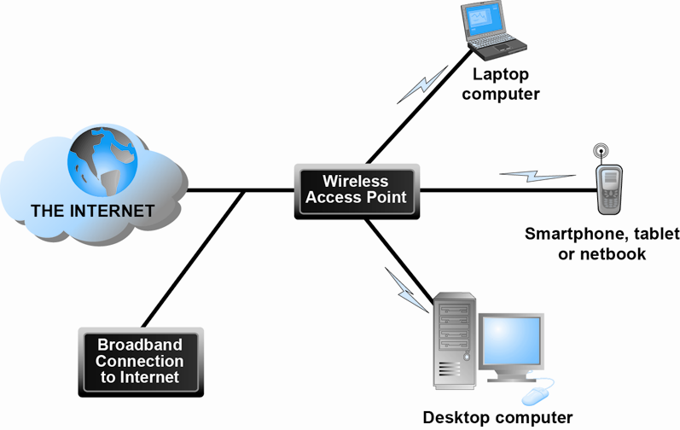
Wi-Fi Networks
Figure 3.15, Page 96
Copyright © 2014 Pearson Education, Inc.
Slide 3-<number>

Slide 31
The Future Internet
Latency solutions
Guaranteed service levels and lower error rates
Declining costs
The Internet of Things (IoT)
  Objects connected via sensors/RFID to the Internet
  Spearheaded by EU and China
  IBM’s Smarter Planet initiative
Copyright © 2014 Pearson Education, Inc.
Slide 3-<number>

Slide 32
The Web
1989–1991: Web invented
  Tim Berners-Lee at CERN
  HTML, HTTP, Web server, Web browser
1993: Mosaic Web browser with GUI
  Marc Andreessen and others at NCSA
  Runs on Windows, Macintosh, or Unix
1994: Netscape Navigator, first commercial Web browser
  Andreessen, Jim Clark
1995: Microsoft Internet Explorer
Copyright © 2014 Pearson Education, Inc.
Slide 3-<number>

Slide 33
Hypertext
Text formatted with embedded links
  Links connect documents to one another, and to other objects such as sound, video, or animation files
Uses Hypertext Transfer Protocol (HTTP) and URLs to locate resources on the Web
  e.g.: http://megacorp.com/content/features/082602.html
Copyright © 2014 Pearson Education, Inc.
Slide 3-<number>

Slide 34
Markup Languages
Hypertext Markup Language (HTML)
  Fixed set of pre-defined markup “tags” used to format text
  Controls look and feel of Web pages
  HTML5 the newest version
eXtensible Markup Language (XML)
  Designed to describe data and information
  Tags used are defined by user
Copyright © 2014 Pearson Education, Inc.
Slide 3-<number>

Slide 35
Is HTML5 Ready for Primetime?
What features of HTML5 are changing the way Web sites are built?
Is HTML5 a disruptive technology, and if so, for whom?
Are there any disadvantages in Web sites and mobile apps moving to an HTML5 platform?
Copyright © 2014 Pearson Education, Inc.
Slide 3-<number>

Slide 36
Web Servers and Web Clients
Web server software
  Enables a computer to deliver Web pages to clients on a network that request this service by sending an HTTP request
  Apache, Microsoft IIS
  Basic capabilities: Security services, FTP, search engine, data capture
Web server
  Web server software or physical server
  Specialized servers: Database servers, ad servers, etc.
Web client:
  Any computing device attached to the Internet that is capable of making HTTP requests and displaying HTML pages
Copyright © 2014 Pearson Education, Inc.
Slide 3-<number>

Slide 37
Web Browsers
Primary purpose to display Web pages
Internet Explorer—49% of market
Mozilla Firefox—18%
  Open source
Other browsers
  Google Chrome—17%
  Apple Safari—11%
Copyright © 2014 Pearson Education, Inc.
Slide 3-<number>

Slide 38
The Internet and Web: Features
Features on which the foundations of
e-commerce are built:
  E-mail
  Instant messaging
  Search engines
  Online forums and chat
  Streaming media
  Cookies
Copyright © 2014 Pearson Education, Inc.
Slide 3-<number>

Slide 39
E-mail
Most used application of the Internet
Uses series of protocols for transferring messages with text and attachments from one Internet user to another
Instant Messaging
Displays words typed on a computer almost instantly, and recipients can respond immediately in the same way
Copyright © 2014 Pearson Education, Inc.
Slide 3-<number>

Slide 40
Search Engines
Identify Web pages that match queries based on one or more techniques
  Keyword indexes, page ranking
Also serve as:
  Shopping tools
  Advertising vehicles (search engine marketing)
  Tool within e-commerce sites
Outside of e-mail, most commonly used Internet activity
Copyright © 2014 Pearson Education, Inc.
Slide 3-<number>

Slide 41
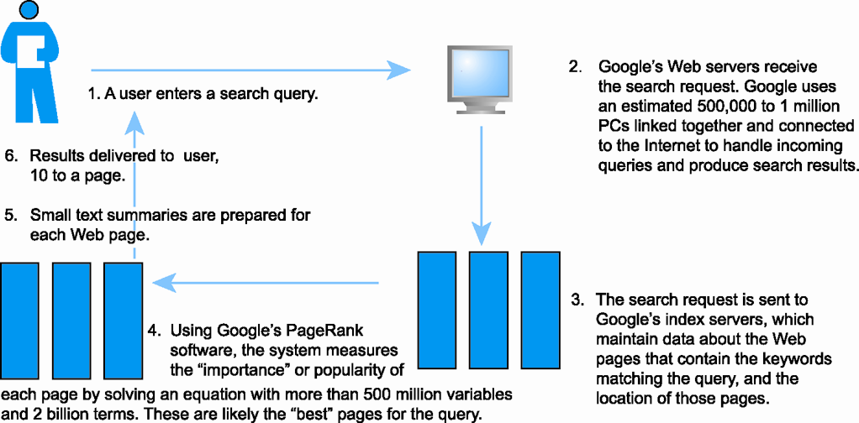
How Google Works
Figure 3.20, Page 106
Copyright © 2014 Pearson Education, Inc.
Slide 3-<number>

Slide 42
Online Forums and Chat
Online forum
  Also known as a message board, bulletin board, discussion board, discussion group, board or forum
  Web application that enables Internet users to communicate with each other, although not in real time
  Members visit online forum to check for new posts
Online chat
  Similar to IM, but for multiple users
  Typically, users log into chat room
Copyright © 2014 Pearson Education, Inc.
Slide 3-<number>

Slide 43
Streaming Media
Enables music, video, and other large files to be sent to users in chunks so that when received and played, file comes through uninterrupted
Allows users to begin playing media files before file is fully downloaded
Copyright © 2014 Pearson Education, Inc.
Slide 3-<number>

Slide 44
Cookies
Small text files deposited by Web site on user’s computer to store information about user, accessed when user next visits Web site
Can help personalize Web site experience
Can pose privacy threat
Copyright © 2014 Pearson Education, Inc.
Slide 3-<number>
Slide 3-<number>

Slide 45
Web 2.0 Features and Services
Online Social Networks
  Services that support communication among networks of friends, peers
Blogs
  Personal Web page of chronological entries
Really Simple Syndication (RSS)
  Program that allows users to have digital content automatically sent to their computers over the Internet
Copyright © 2014 Pearson Education, Inc.
Slide 3-<number>

Slide 46
Web 2.0 Features and Services
Podcasting
  Audio presentation stored as an audio file and available for download from Web
Wikis
  Allows user to easily add and edit content on Web page
Music and video services
  Online video viewing
  Digital video on demand
Copyright © 2014 Pearson Education, Inc.
Slide 3-<number>
Slide 3-<number>

Slide 47
Web 2.0 Features and Services
Internet telephony (VOIP)
  Voice over Internet Protocol (VOIP) uses Internet to transmit voice communication
Intelligent Personal Assistants
  Software that interacts with the user through voice commands
  Natural language, situational awareness, interactivity with various Web services
Copyright © 2014 Pearson Education, Inc.
Slide 3-<number>

Slide 48
Mobile Apps
Use of mobile apps continues to explode in 2012
  70% of mobile phone owners research products and services, 35% have made purchase
Increased use/purchasing from tablets
Platforms:
  iPhone/iPad, Android, Blackberry
App marketplaces:
  Google Play, Apple’s App Store, RIM’s App World, Windows Phone Marketplace
Copyright © 2014 Pearson Education, Inc.
Slide 3-<number>
Slide 3-<number>

Slide 49
Apps for Everything: The App Ecosystem
What are apps and why are they so popular?
Do you use any apps regularly? Which ones, and what are their functions?
What are the benefits of apps? The disadvantages?
Are there any benefits/disadvantages to the proprietary nature of the Apple platform?
Copyright © 2014 Pearson Education, Inc.
Slide 3-<number>

Slide 50

Copyright © 2014 Pearson Education, Inc.
Slide 3-<number>

